Slide 4
DON’T FAIL YOUR IOT PROJECT:
IOT LESSONS-LEARNED AT VATTENFALL (CIO & DEV)
Mikael Söderström
Solution Architect EAI
Vattenfall
Mikael Håkansson
Solution Architect
Axians IoT Nordic

Slide 5

We need change…

Slide 6
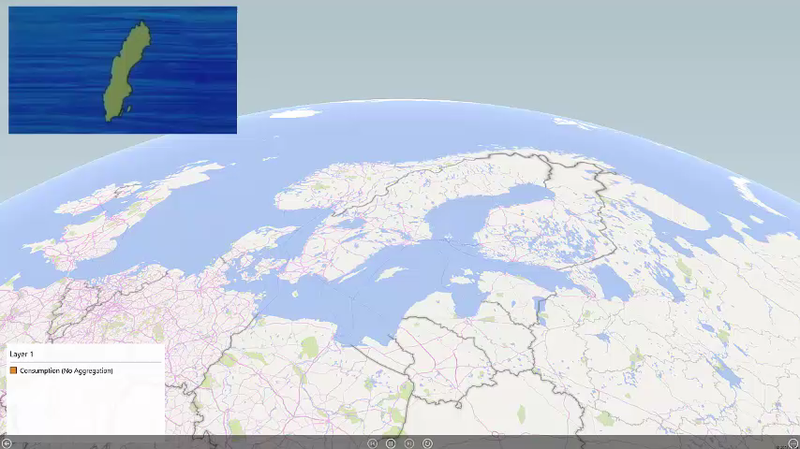

Slide 7
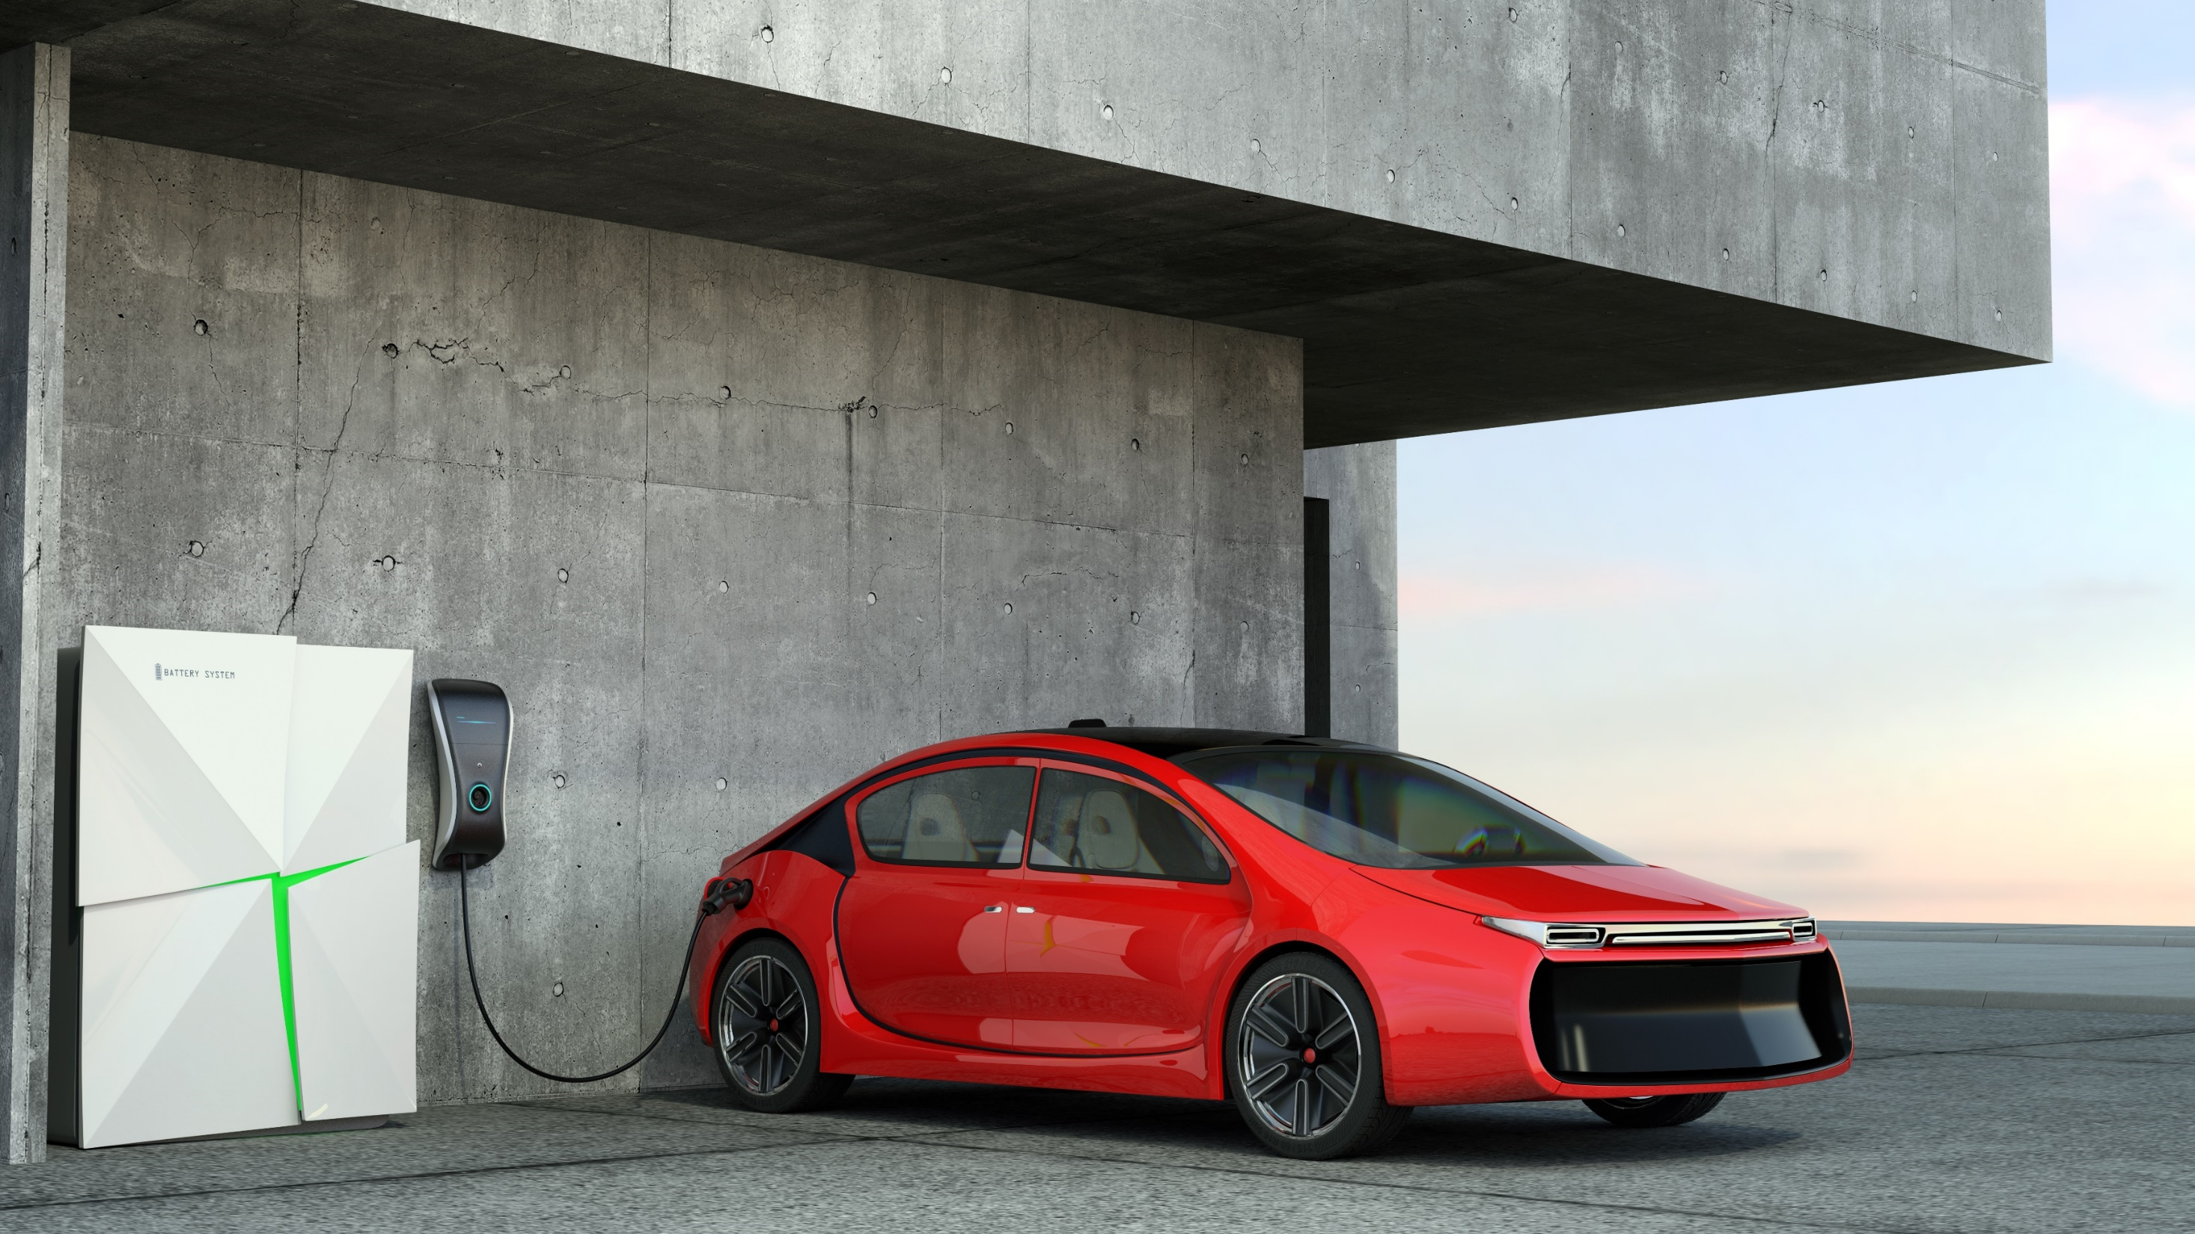
New challenges …

Slide 8

New challenges …

Slide 9
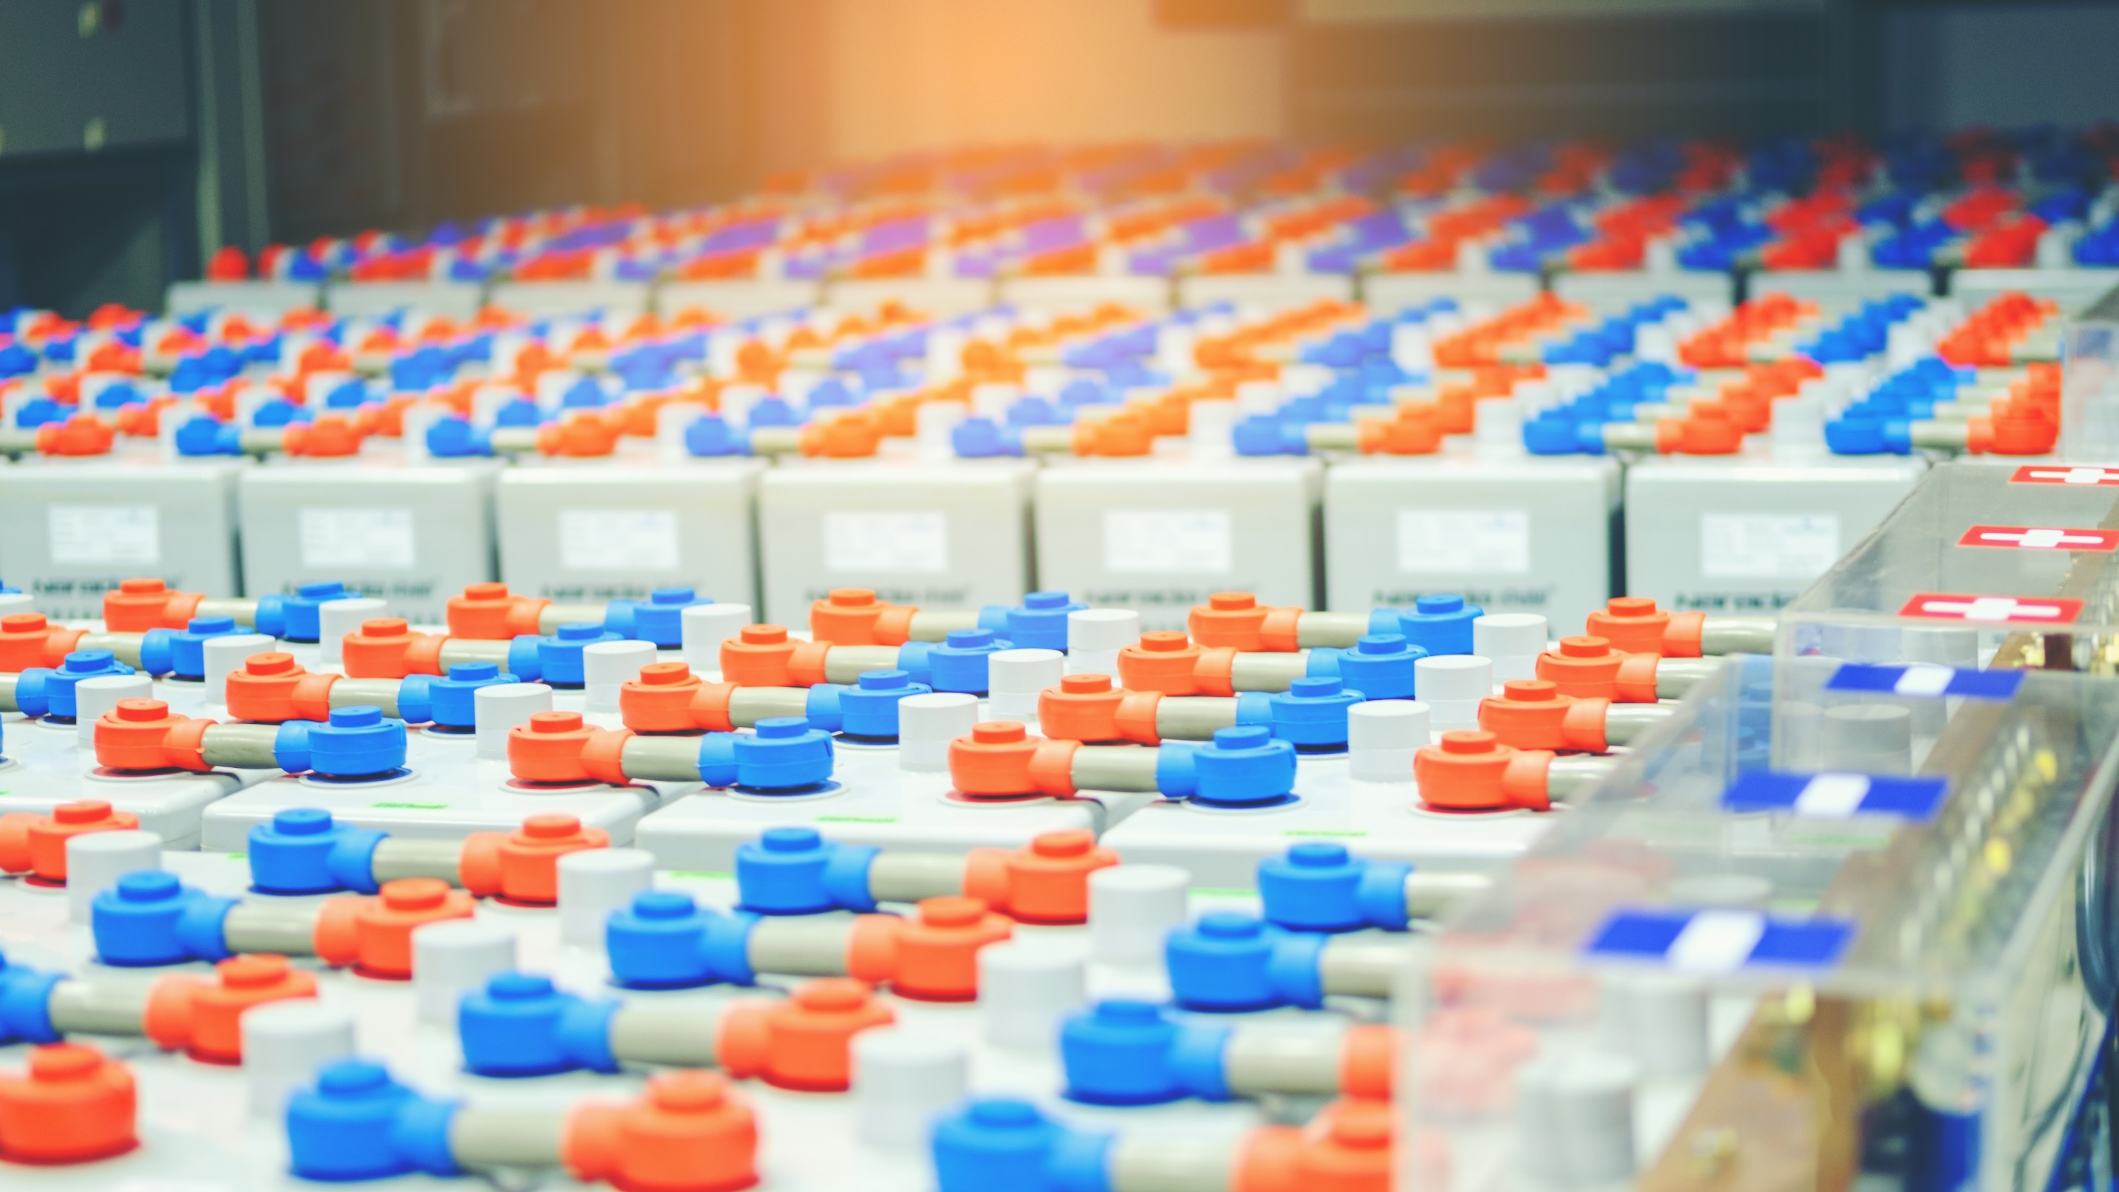
New opportunities …

Slide 10
Vattenfall - Peak Shaving

Slide 11



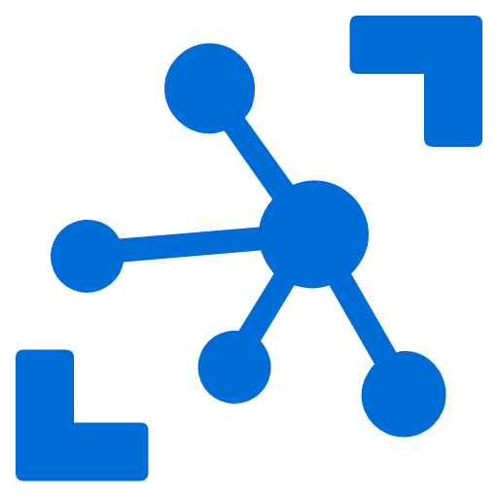


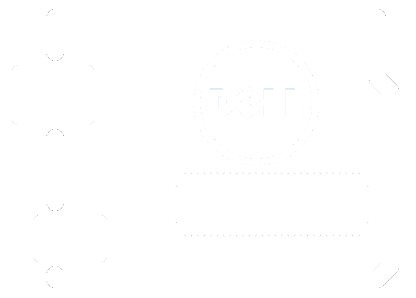



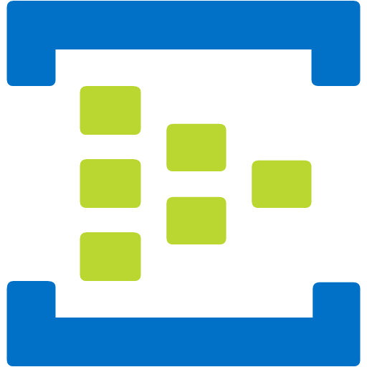






Vattenfall – Prometheus Peak-shaving (DE)
Matlab / SimuLink
vattenfall.microServiceBus.com
Code updates
Device Management
Site
Power meter
IoT Hub
Forecast data (1/24h)
Field Gateway
Solar
Forecasting
Consumption data (10 MHz)
Optimization
Charging controller
Battery controller
Wind
EV
Battery
Spot Price
Weather
Grid
Notes:
Connecting your devices is the 1st challenge that you have when creating an IoT solution. There is a vast variety of devices you may want to connect. Some are internet capable and in that case you can connect them directly to Azure service (eg: IoT Hub) or you can use your own Cloud protocol gateway in case the device you are trying to connect does not have a protocol supported by IoT Hub (at this time AMQP or HTP). However, some devices are not internet capable and those devices need a field gateway to connect to the cloud. This gateway can do many things – not only connectivity and protocol translation but on the application back end side, one of the most important use cases is telemetry. You usually want to have an event processing and insight pipeline and IoT Hub will allow you to get a feed from the devices and events easily.
The 2nd big component that IoT solutions have with cloud is device big logic that takes care of interactive scenarios of your solutions – think about opening your car door or adjusting your home thermostat from your smart phone or sending a command to a device to update a piece of firmware.
Finally IoT Hub has to know which devices have to connect and which devices are present for IoT solution. For this purpose it has to interact with the visioning and management component which is the component that makes sure that the devices are on-boarded and de-provisioned correctly from your own IoT solutions.

Slide 12
Challenges
SKILLSETS
ON-BOARDING
MANAGE UPDATES

Slide 13



Diversity of skillsets
On-site installation
FIELD ENGINEERS
DEVELOPERS
IOT | CLOUD | DATA
BUSINESS ANALYSTS

Slide 14
Diversity of skillsets
On-site installation
FIELD ENGINEERS
DEVELOPERS
IOT | CLOUD | DATA
BUSINESS ANALYSTS

Slide 15




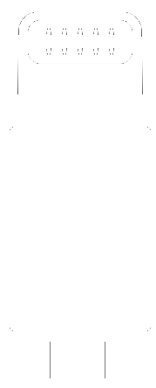
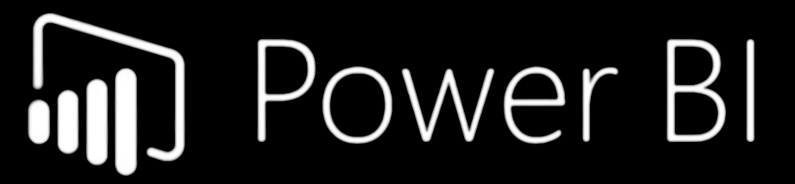
Diversity of skillsets
On-site installation

Slide 16

Diversity of skillsets
Modbus - Serial or TCP based communications protocol
PLC - Programmable Logic Controllers
Read | Writer
Baudrate
Register address
Length
METER
IOT DEVICE

Slide 17
Demo * Koppla ihop device, lampa och mätare * Visual Code * Visa i PBI

Slide 18
DEMO
Reading data and submitting it to the cloud

Slide 19

ON-BOARDING
INSTALLATION
Technician goes to site and installs gateway, meters and sensors
OUTPUT
All meters & sensors in place
Gateway is mounted, configured and connected to Azure IoT

Slide 20


On-boarding
4. Register device
3. Notification
IOT HUB
SIM CARD MANAGEMENT
IoT Hub
microServiceBus.com
DEVICE MANAGEMENT
5. Credentials
6. Config
2. Request config
?
7. Send & Receive
1. Activate SIM card
IOT DEVICE

Slide 21
DEMO
- Onboarding

Slide 22

Presentation title
CODE-B599
Speaker Name

Slide 23
Section title

